Slide 1

Connected Operations (COps) Platform
Team 32: Jonathan Balliet, Jeen Shaji (Presenters), Caleb Boswell, Daniel Mills, Spencer Yoder
Notes:
Good afternoon everyone. I am Jeen Shaji. Me and Jonathan will be presenting about our project Connected Operations platform

Slide 2
Content
Project Recap
Requirements
Design
Demo
Current Iteration
Action Steps
Notes:
We will do a short recap of our project, requirements and design. Followed by a quick demo, current iteration updates and planned action steps

Slide 3
Project Recap
Skyward Federal: Cyber-Logistics startup
Create secure custom applications for government clients
Data is usually separated physically by security level
Inefficient and multiple points of failure
Problem: how to create a centralized, virtualized, multi-level security data store?
Notes:
Skyward federal is a cyber-logistics startup with about 10 employees. They create secure custom application for government clients.
To solve this, Skyward federal wants us to create a Common Operations Platform

Slide 4
Overall Requirements
The system shall receive data from multiple external sources
The system shall categorize, label, and store data
Users shall be able to read data, write data, and view reports
The system shall execute or deny requests based on the user’s security context
The system shall be interfaced via an API endpoint
Notes:
System receives data from n number of external sources
For example: Categories like unclassified, confidential, secret and top secret
System allows user interaction with the database. They can read and write
** System will either approve or deny this access request based on their security context.

Slide 5
Constraints
System shall run on CentOS 7 with SELinux enabled
PostgreSQL shall be used as our database
Docker Containers shall be used to run RESTful services
Notes:
Skyward Federal wants the system to run on a CentOS 7 with SELinux. SELinux is used as our security module
They also want us to use postgreSQL as our database because of its integration with SELinux
We can see from our requirements that these are very abstract. In iteration 1, we specified a concrete system which fulfills all these abstract requirements. It is called the COURSE MANAGER.

Slide 6
Course Manager
3 Users: Coordinator, Instructor and Student
 | UC 1 | UC 2 | UC 3 | UC 4 | UC 5 | UC 6 | UC 7
 | Login | View Account | Edit Course | Edit User | Edit Grade | View Schedule | View Logs
Coordinator
Instructor
Student
Notes:
For our mock system called Course Manager, we have 3 users: Coordinators, Instructors and Students.
We have a total of 7 use cases. All of which can be done by the coordinator.
We see see that an instructor can do 4 of these while a student has limited access.
We currently have UC1, 2 and 4 completed. We will see this in the demo later

Slide 7
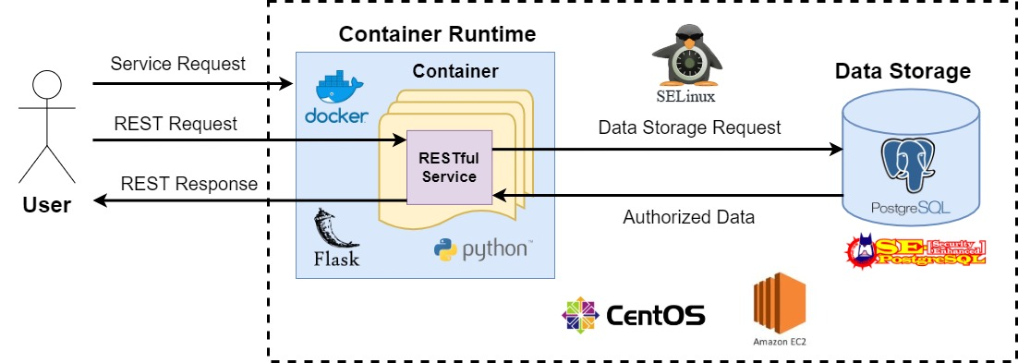
Overall Design
Notes:
User sends service request to the Container Runtime, with their credentials and the name of the service
Container runtime authenticates the user, gives them their level of authorization, and creates a container to run that service with their authorized security levels (SELinux labels)
Successful service request redirects the user to the service
The user can then send REST request to the service, which are processed by the Data Storage.
On the kernel level, the data storage allows or denies requests based on the enforced security levels of the user
A response is then sent back to the user. The user’s interaction with this service continues until they disconnect.
In order to create a concrete system, we have created a mock system using the Course Manager service

Slide 8
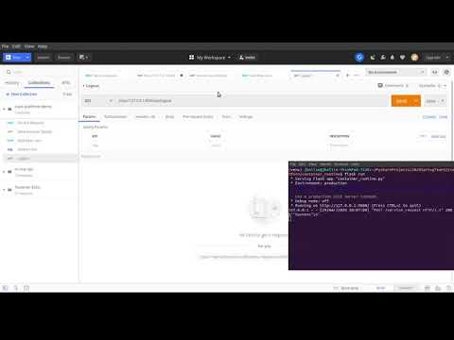
Demo
JB

Slide 9
Overall Design
Notes:
Focus now on the Container Runtime as we showed off in the previous demo.

Slide 10
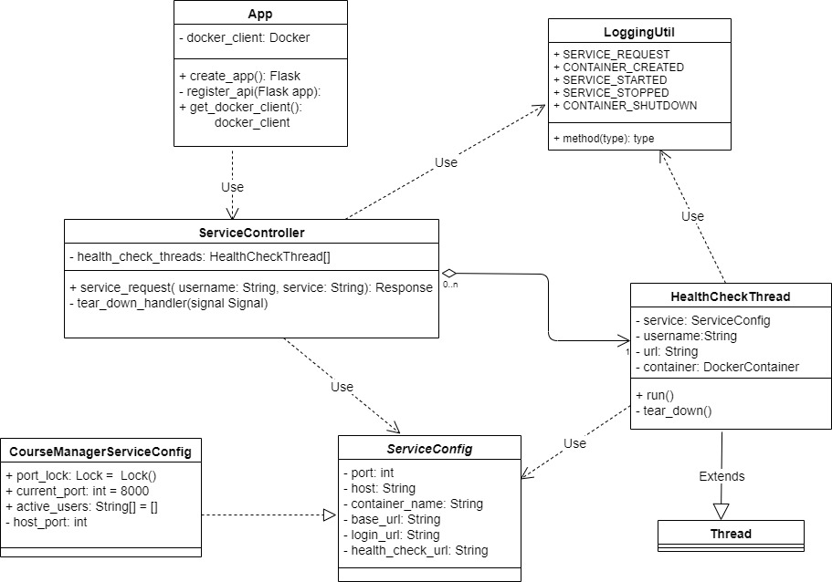
Iteration 2 - Container Runtime UML Class Diagram
JB
Notes:
App - runs and initializes Container Runtime application. Docker_client - we use this to communicate with the Docker Service
Service Controller - POST request endpoint to handle service request from the user. Passes in username and service name. Creates container with the authorization levels of the user
Service Config - Abstract class containing all the fields a service needs to work with our application. The Course Manager Service Config class is an concrete implementation for our Course Manager Service
HealthCheckThread - We can easily create multiple running containers via our Docker client.. but how do we monitor all of the containers? Use a thread to check a special endpoint on the service running in a container every 30 seconds.
When the user’s session ends - we know we can then shut down this container.
LoggingUtil - Logs all the transactions that occur in the Container Runtime

Slide 11
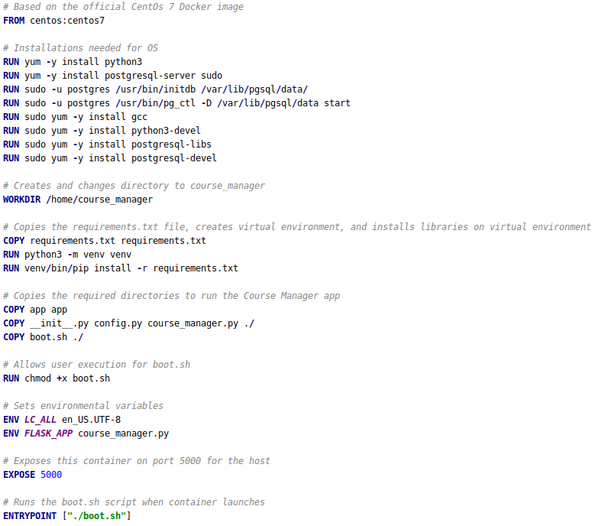
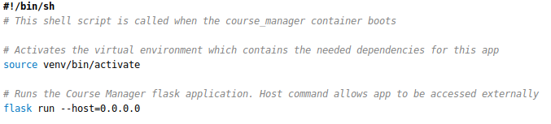
Code: Dockerfile for Course Manager
JB
Notes:
Dockerfile is just a process running in a specific OS image with all the dependencies installed it needs to run an application
Based on the CentOs7 operating system image
Installs all the python and postgres libraries Course Manager needs to run
Copies and creates the Course Manager Flask application
Initializes OS settings needed to run application in the container on the host machine
Boot shell script is run when the container starts. Starts up the virtual environment and runs Course Manager
Still needs to be integrated with SELinux!

Slide 12
Overall Design
Notes:
How to secure the system? Depends on SELinux integrated with all components.

Slide 13
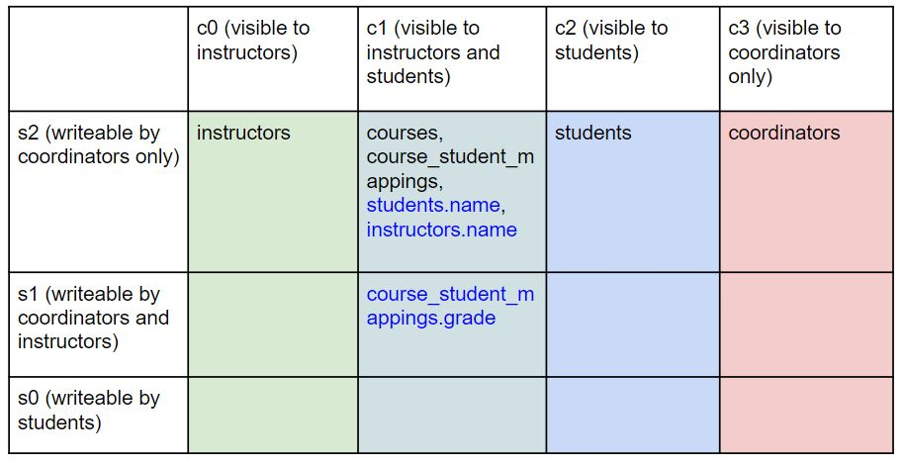
Recap - Previous SELinux Policy
Security Labels
Coordinator
s2:c0.c3
Instructor
s1:c0.c1
Student
s0:c1.c2
SY
Notes:
This was our previous SELinux Policy

Slide 14
Iteration 2 - SELinux Policy Changes
SELinux Policy changes since last time
Moved from a modified MLS policy to a simpler type enforcement policy
Now, we have types for each user and can manually designate which data types are accessible to which user types
Example:
postgres_u:coursemanager_r:instructor_t:s0
system_u:object_r:course_student_mapping_t:s0
SY & DM
Notes:
Understanding of SELinux has changed, along with struggling with how complicated it is
Now using type enforcement
Basically does the same thing as MLS (restricting what a running process is allowed to do) but easier for us to implement. We agreed with our sponsors on this change
Created a full custom policy module which mocks the kinds of operations performed by CourseManager
The top one is for the instructor user, the bottom one is for the course_student_mapping table

Slide 15
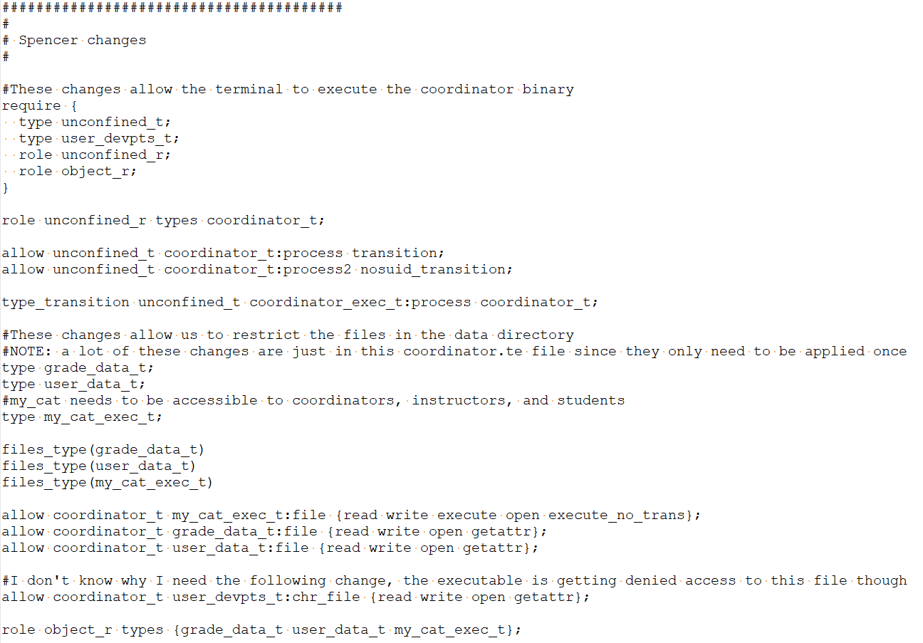
Code: SELinux Policy Modules
Preexisting SELinux types
Start up a process with a new context
Create new data types
Create new SELinux rules
SY
Notes:
Example of our coordinator process policy
Require - reference stuff that is already created (like importing libraries)
Create the coordinator process with a newly defined security context
Define new data types that will be used in this security policy
Create the SELinux rules for this coordinator process
Enforces what the process can do to the defined data types (read, write, execute, etc.)

Slide 16
Status of Project
Our goal:
CentOS 7 Machine
User
Docker Container
REST Requests
CourseManager
Postgres Database
SELinux Security Policy
JSON responses
SY
Notes:
Our Goal is to have all components : Course Manager, Docker and POstgres working on a centOS 7 machine with SELinux enabled

Slide 17
Status of Project
Our current status:
Ubuntu Machine
CentOS 7 Machine
User
Docker Container
Postgres Database
SELinux Security Policy
REST Requests
CourseManager
JSON responses
Postgres Database
SY
Notes:
Main components of project are done and working on Ubuntu without SELinux enforced

Slide 18
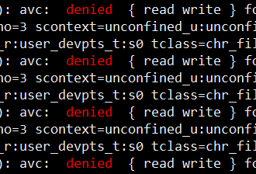

Challenges
SELinux is complicated, and poorly documented
Difficult to automate SELinux due to complex debugging process
Resolutions
Creating our own documentation
Formalizing the debugging process
DM, CB, & SY

Slide 19
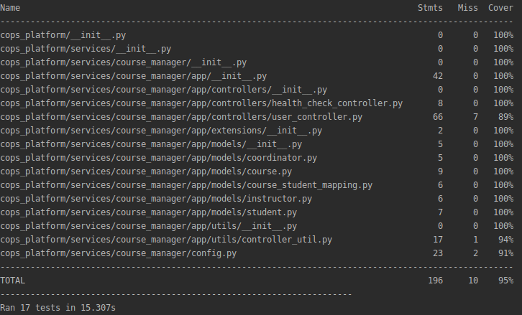
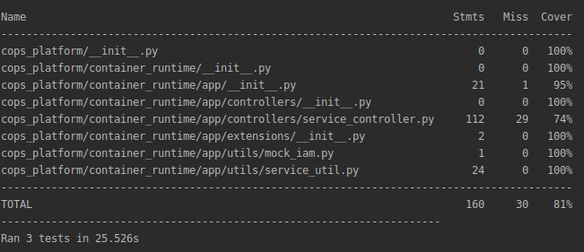
Testing Progress
Unit and Integration Tests - Completed
Coverage
Course Manager - 95 %
Container Runtime - 81 %
System Tests - Incomplete
JB, CB, & JS
Notes:
We need to bring everything together on the CentOS 7 development machine and integrate with the SELinux module
This way we can finally do System Testing for the security of our system.

Slide 20
Action Steps
Finish Iteration 2 (April 10th)
Integrate Course Manager on CentOS 7 enabled with SELinux
Have one REST API correctly working in our end-to-end in system
Make progress on developers guide and installation guide
Start frontend code
Iteration 3 (April 21st)
Finish remaining Use Cases for Course Manager
System Testing for all REST API calls
Integrate SELinux policies with Docker Container
Finish developers, installation and user guide
JS & JB

Slide 21
Conclusion
Significant progress on Course Manager use cases
Dockerized running Course Manager service
Implemented Container Runtime
Implemented custom SELinux policy
Need to integrate everything together
SELinux is the “glue” that the security of our system depends on
DM & JB

Slide 22
Questions?

